Slide 1
Pathway Analysis
Juliana Ng
08/17/2026

Slide 2
Table of contents
01
02
Approaches
Over-Representation Analysis (ORA)
03
Functional Class Scoring (FCS)

Slide 3

01
Notes:
This is an old paper, published in 2012

Slide 4
What is pathway analysis?
A pathway is a set of genes that work together to carry out a biological function.
Pathway analysis is a bioinformatics analytical approach applied to sequencing data to interpret biological meaning in lists of genes at the gene-set level.

Slide 5
Why?
Reduces complexity
Determines whether a pathway is statistically over- or under- represented in a certain phenotype
Increases explanatory power

Slide 6
Limitations of gene-level statistics
Significance
Interpretability
Not many "significant" genes after multiple hypothesis correction, and biological difference can be small relative to background signal
Long lists of genes without a unifying biological theme
Pathway effect
Reproducibility
Pathway effect can be missed because genes work together.
Lists of significant genes are not consistent when the same study is repeated
Notes:
Pathway effect: Change in 20% of the genes in a pathway may have more effect than one gene with 20 fold change

Slide 7
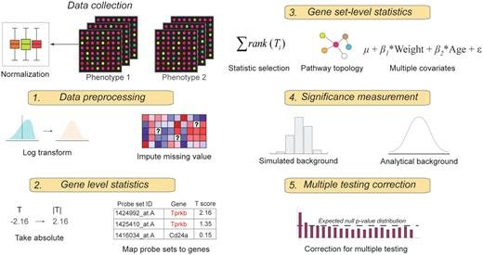
When is it performed?
After differential gene expression analysis.

Slide 8
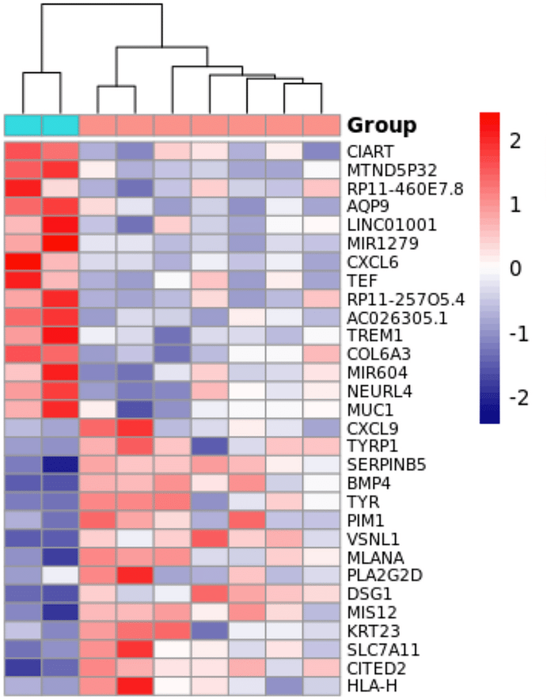
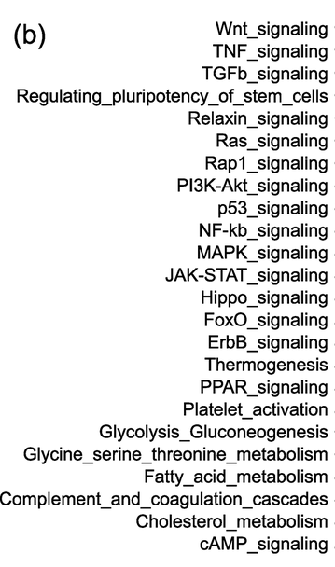
How?
By correlating gene expression data to pathways in the knowledge base to identify changes in pathways in your data

Slide 9
Three generations of pathway analysis
Over Representation Analysis (ORA)
1st generation 2000-2002
Functional Class Scoring (FCS)
2nd generation 2003-2005
Pathway Topology based approaches
3rd generation 2005

Slide 10


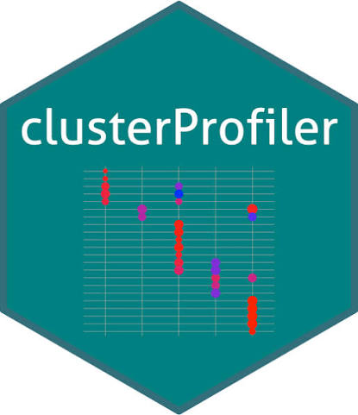
Over Representation Analysis (ORA)
Evaluates a subset of differentially expressed genes for over-/under-representation
Statistics:
Hypergeometric distribution; Fisher's exact test
Binomial distribution; Chi-Square test
Limitations:
Genes are treated equally and the statistics consider the number of genes but not the expression values​
Tools:
gProfiler​
Metascape​​
Most tools are similar because of similar statistics used & overlapping databases​
Arbitrary threshold > subset of genes > information loss​​
clusterProfiler
Assumes genes act independently​​​
Assumes pathways act independently​​​​
Notes:
How are the genes subsetted?
By criteria like the p value, change in expression, etc.
e.g. p <= 0.05 and abs(fold change) >= 2
Hypergeometric distribution: successes without replacement in a finite population
Binomial distribution: successes with replacement
Fisher's exact test: checks for association in categorical variable in small population
Chi-Square test: checks for association in categorical variable in big population
Fisher's & Chi Square tests are like t-test but for categorical variables

Slide 11

Functional Class Scoring (FCS)
Hypothesis: Large changes have significant effects but weak and coordinated changes in functionally related genes can also have significant effects
Statistics:
Kolmogorov-Smirnov
Wilcoxon rank sum
Sum, mean, median, maxmean
Advantages:
No arbitrary threshold​
Considers expression values accounting for gene dependence in a pathway​
Limitations: ​
Tools:​
Assumes pathways act independently
GSEA​​
Genes in different pathways with the same rank are treated equally even if the expression values are different ​​
Notes:
Kolmogorov-Smirnov test: same goal as t-test but it's non-parametric and makes no assumption about the data. The shape of the distribution doesn't have to be normal and it is sensitive to and can detect shifts in mean, variance, skewness, and peaks, unlike t-test, which only detects the shift in mean
Wilcoxon rank sum: similar to KS test but it detects the shift in median, so it is more robust to outliers. It also doesn't assume the data is normally distributed so it is great for skewed data
Maxmean: statistic developed for GSA, calculates the average for positive and negative pathways separately then take the maxvalue
Pathways don't act independently, the same gene in be in other pathways, therefore pathways overlap

Slide 12
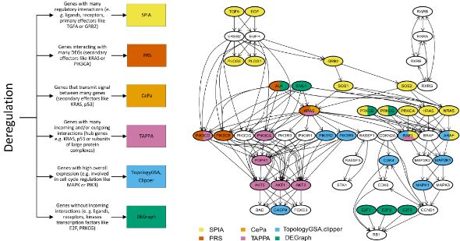
Pathway topology-based approaches
Computes pathway statistics using network graphs accounting for interactions and directionality of pathways
Notes:
At the time the paper was published, this approach was still new, knowledge base was fragmented and methods were difficult to generalize. Now this approach has matured and more tools have come out.
The paper also mentioned several challenges about pathway analysis but it's an old paper and some challenges may have been addressed. I didn't dig deep into that, since it's not really the point of this presentation

Slide 13
02
Over Representation Analysis

Slide 14
Some ORA tools
gProfiler
Web-based
Metascape
Web-based
clusterProfiler
R

Slide 15
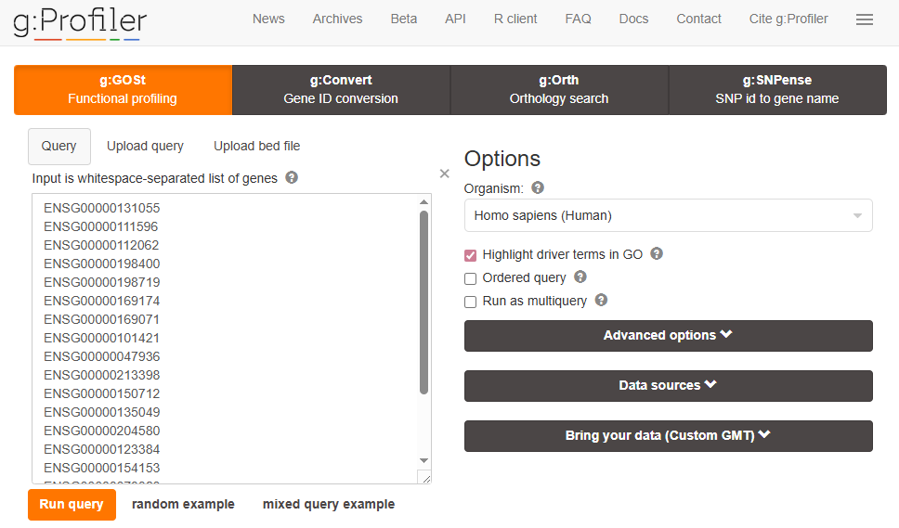
gProfiler

Slide 16
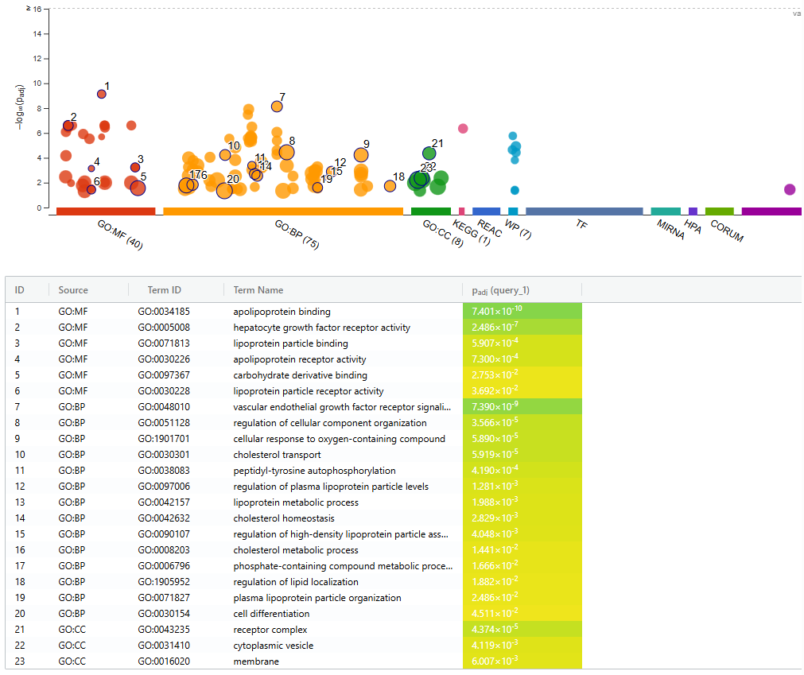

Slide 17
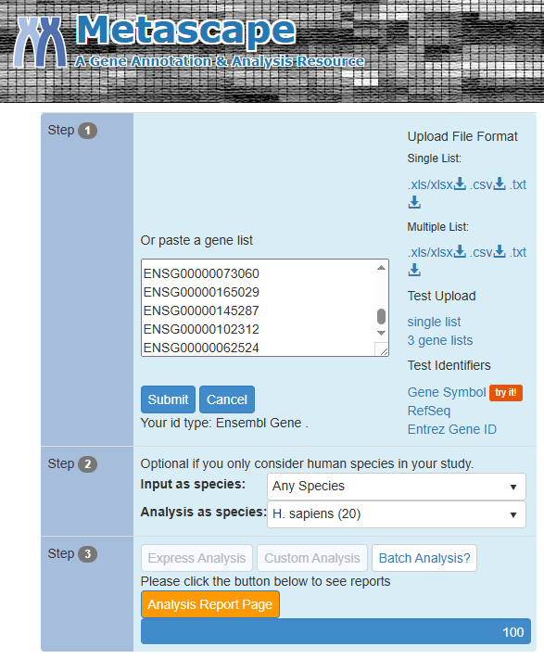
Metascape

Slide 18
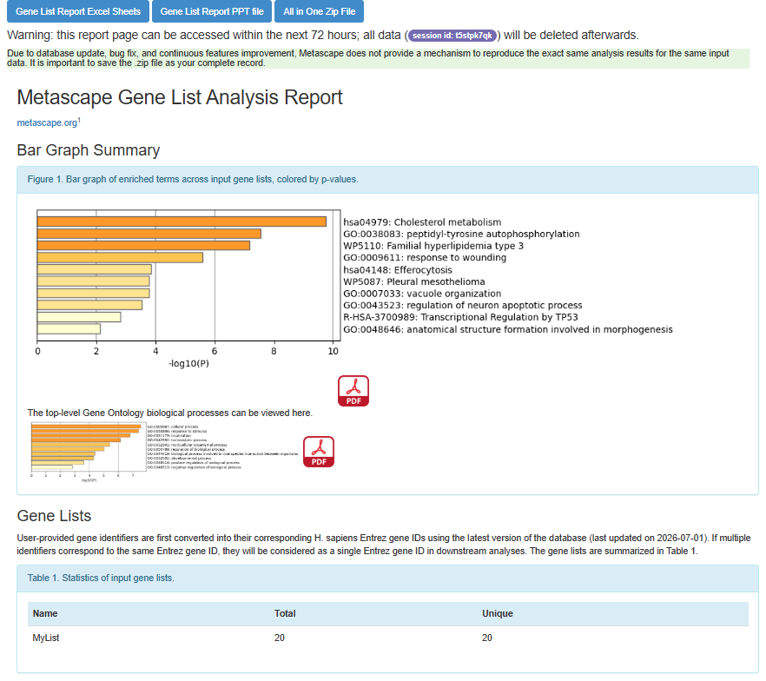

Slide 19
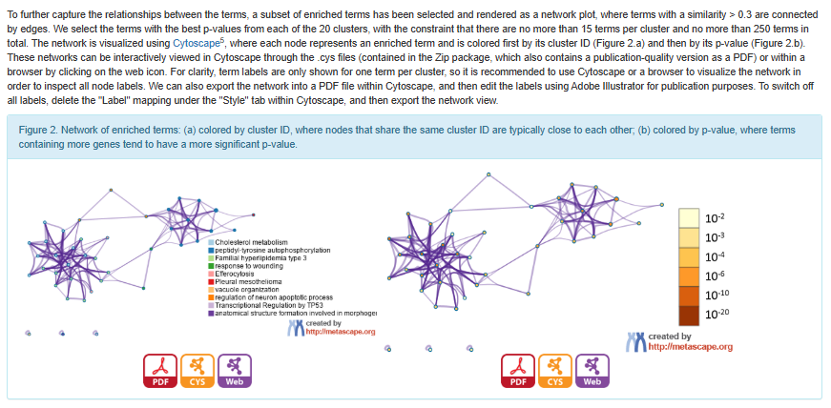

Slide 20
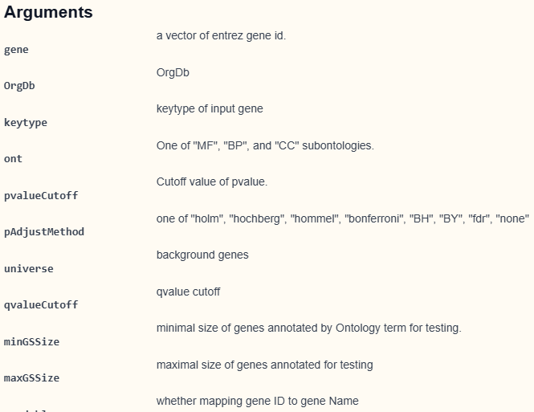
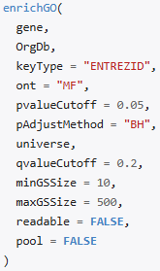
clusterProfiler

Slide 21
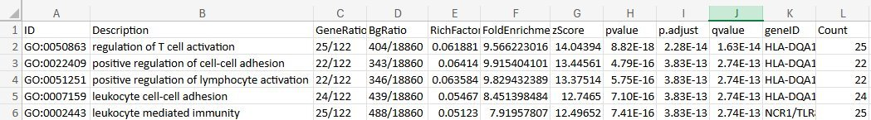

Slide 22
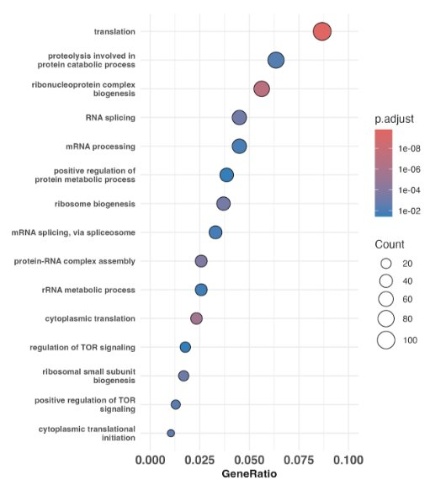

Slide 23
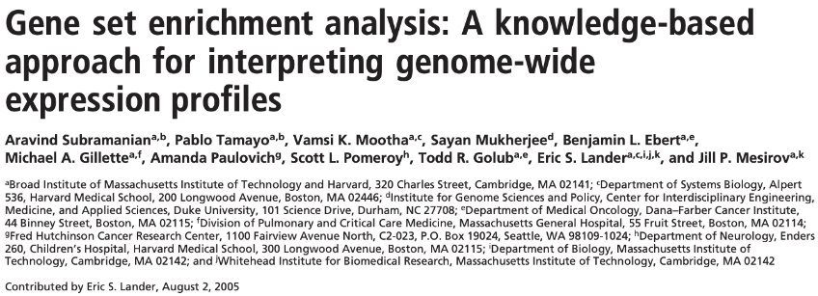
03

Slide 24
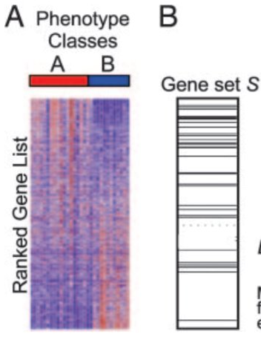
"The goal of GSEA is to determine whether members of a gene set S tend to occur toward the top (or bottom) of the list L, in which case the gene set is correlated with the phenotypic class distinction."
Notes:
L = all genes in sequencing run, usually with 2 phenotype classes e.g. treatment vs control. Sometimes there will be more phenotype labels but GSEA will only compare 2 groups at a time
S = gene list of interest
Fig B the entire box is L, the lines are genes in S

Slide 25

Notes:
We want to know if the genes are randomly distributed randomly, towards the top or the bottom. We expect pathways correlated to a specific phenotype to be distributed towards the top or bottom, not randomly.

Slide 26
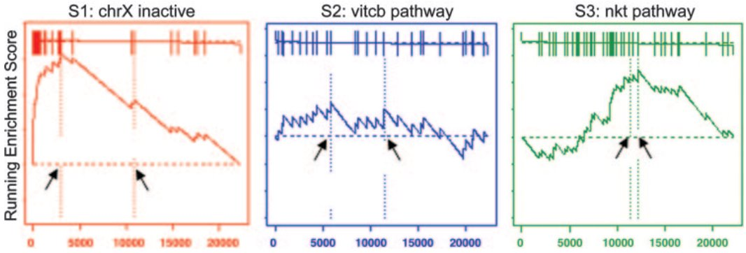
Enriched towards the top
Randomly distributed
Not enriched towards the top but nonrandom

Slide 27
Three key elements of GSEA
Enrichment Score (ES)
Nominal p-value
Multiple Hypothesis Correction

Slide 28
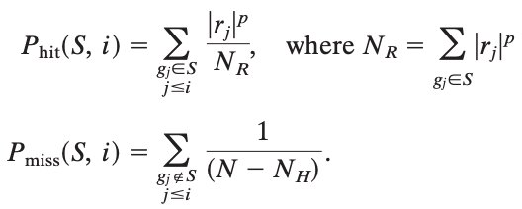

Enrichment Score (ES)
It is the correlation of the gene set S with the phenotype, how much it is over-/under-represented in the ranked list L
The score is the maximum deviation from 0, corresponding to Kolmogorov-Smirnov like statistic​
Calculated by walking down the list L, increasing the running-sum-statistic when a gene in S is encountered, decreasing when not​

Slide 29
Nominal p-value
Estimated by empirical phenotype-based permutation test
Permute phenotype label​
Construct null distribution​
Preserves gene-gene correlation and structure of gene expression data​​
Calculate p-value​​

Slide 30
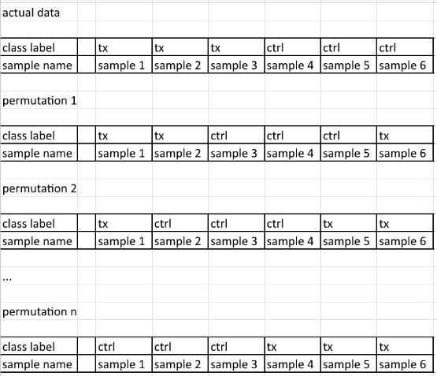

Nominal p-value
Permute phenotype label

Slide 32
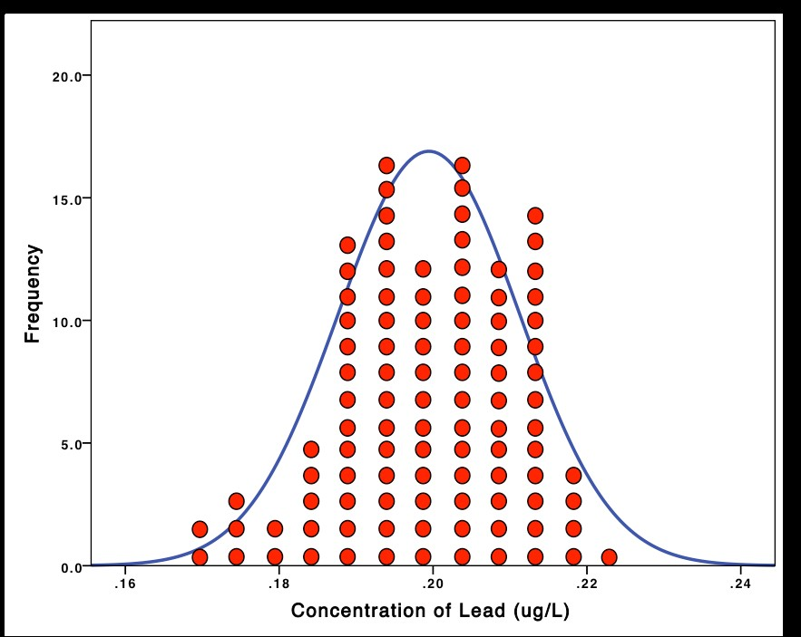
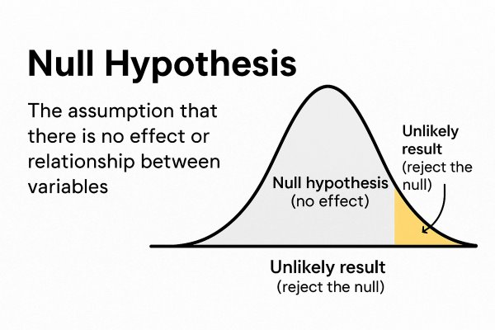

Nominal p-value
Enrichment Score (ES)
Permute phenotype label
Calculate ES for each permutation to form a null distribution
Compare ES of observed data to null distribution to calculate p-value

Slide 33

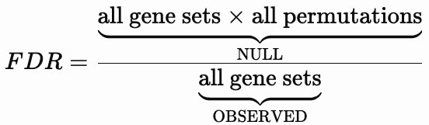


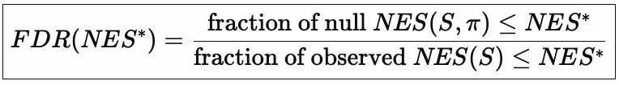
Multiple Hypothesis Correction
False Discovery Rate (FDR): The rate gene sets are considered significant at that particular Normalized Enrichment Score (NES) threshold are false positives
Notes:
e.g. NES = 3, FDR = 25% (0.25)
25% of the gene sets considered significant with NES >= 3 may be false positive

Slide 34
Leading edge subset
"genes in the gene set S that appear in the ranked list L at, or before, the point where the running sum reaches its maximum deviation from zero"
"core members of high scoring gene sets that contribute to the ES"
Can be used to identify overlapping subset of genes within high scoring gene sets

Slide 35

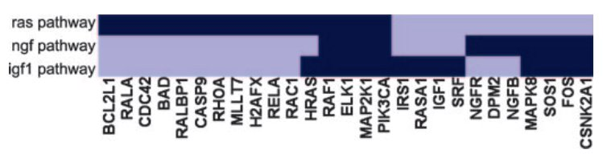

Slide 36
Glossary
Pathway: a set of genes that work together to carry out a biological function
Pathway Analysis: method to interpret lists of genes in transcriptomic data
Over-Representation Analysis (ORA): evaluates a subset of genes for over-/under-representation
gProfiler, Metascape: web-based tools for ORA
clusterProfiler: R package available on Bioconductor for ORA
Gene Set Enrichment Analysis (GSEA): inputs all genes from the data and determines whether genes in a gene set are ranked towards the top/bottom
Pathway topology: network graphs of pathways that account for directionality and pathway interactions

Slide 37
Glossary
Hypergeometric distribution: sampling without replacement in a finite population
Binomial distribution: sampling with replacement
Fisher's exact test: checks association in categorical variables in a small population
Chi-Square test: checks association in categorical variables in a big population
Kolmogorov-Smirnov test: non-parametric test for continuous variables, no assumption of data, sensitive to and detects shifts in data shape, mean, variance
Wilcoxon rank sum: non-parametric test for continuous variables, no assumption of data, robust to outliers and detects shifts in median
Maxmean: statistic developed for GSA, calculates the average for positive and negative pathways separately then take the maxvalue

Slide 38
Glossary
Enrichment Score (ES): correlation to how much the gene set S with the phenotype is over-/under-represented in the ranked list, maximum deviation from 0
Normalized Enrichment Score (NES): ES of S /(divided by) mean ES of all permutation of gene set S
False Discovery Rate (FDR): rate of finding false positive result among the significant positive results, at FDR = 25% (0.25), ¼ result is a false positive
Leading edge subset: common genes within high scoring gene sets

Slide 39
Resources (ctrl + click)
Pathway Analysis​
Ten years of pathway analysis: current approaches and outstanding challenges
Over Representation Analysis (ORA)
Pathway enrichment analysis - simple explanation!
GSEA (FCS)
Gene set enrichment analysis: A knowledge-based approach for interpreting genome-wide expression profiles
Gene Set Enrichment Analysis (GSEA) – simply explained!
Gene set enrichment analysis: performance evaluation and usage guidelines
How to interpret GSEA results and plot - simple explanation of ES, NES, leading edge and more!

Slide 40
Thanks!
Do you have any questions?
juliana.ng@northwestern.edu
https://github.com/juliana-ng

